Slide 1
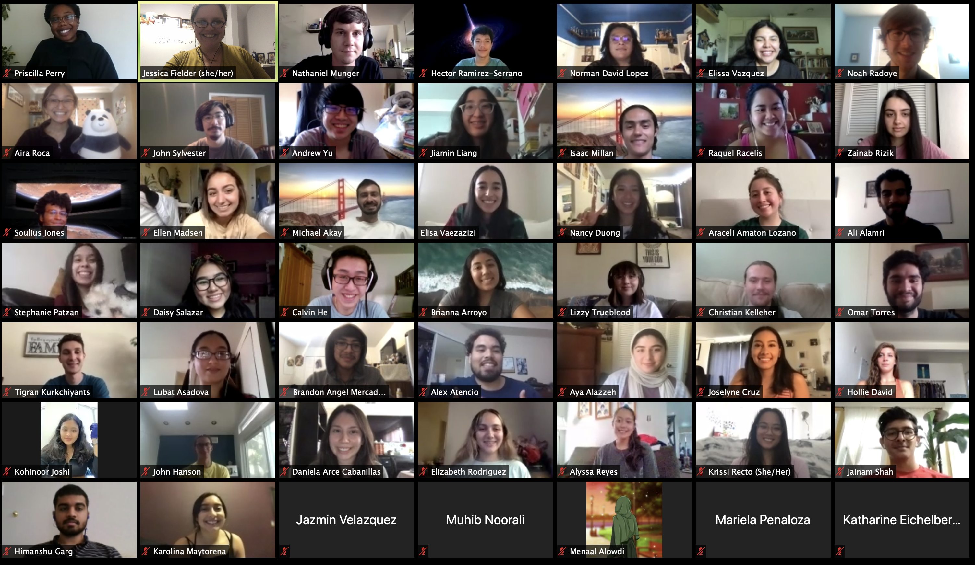
Supplemental Instruction (SI) at SFSU
The 2020-2021 SI Team:
College of Science & Engineering Liaisons and Undergraduate Facilitators
Notes:
Overall Summary.

Slide 2
Overview
Weekly optional 100-min courses, tied to a “parent course”, led by two undergraduate facilitators who lead structured study sessions
We use elements of UMKC SI model and aspects of Peer-Led Team Learning (PLTL)
Students who take SI earn a half-letter grade higher on average, have lower DFW rates

Slide 3
Brief history of SI at SFSU
1999-2005: Supported by NIH grants
Program shut down in 2009 due to lack of funding, revived in Fall 2010 on a smaller scale by CSME with support from CoSE Dean’s office
Support from SF BUILD (F15-F16) enabled shift to undergraduate facilitator pairs
Funding and program size are in flux due to pandemic-related budget cuts

Slide 4
Program Administration
SI classes are housed in College of Science and Engineering under the “SCI” prefix with matched course numbers (where possible)
For example, students in PHYS 111 can take SCI 111
Faculty/GTA dept. liaisons supervise the facilitators, conduct class observations, and run monthly professional development meetings
Course scheduling, hiring, and classroom space are managed by the SI program director

Slide 5
What happens in a SCI class?
Facilitators plan activities around that week’s most important/challenging topics, and lead:
Concept maps
Think-pair-share
Quiz games (Taboo, Kahoot, Jeopardy, etc.)
Lots of time built in for questions and conversation
Notes:
Copy link into chat box: https://www.google.com/url?sa=t&rct=j&q=&esrc=s&source=web&cd=&ved=2ahUKEwi54-WVzJ7uAhXXHDQIHevrCbgQFjAAegQIAhAC&url=https%3A%2F%2Fresources.depaul.edu%2Fsupplemental-instruction%2Fabout%2FPublishingImages%2FStrategy%2520Cards%25207.25.16%2520MASTER.pdf&usg=AOvVaw1e8I2msQtW29dYeSfwullN

Slide 6
Who are the facilitators?
Facilitators are students who have passed the parent class (for example, students who’ve passed Math 199 with a B or better may facilitate SCI 199)
In interviews we look for compassion for other students, understanding of a growth mindset, and (preferably) experience taking a SCI class
Facilitators work in pairs, get pre-semester training and attend monthly meetings

Slide 7
Some Numbers (from Fall 2020)
We ran 31 sections of SCI in support of 20 parent courses, enrolling ~450 students
Our 62 facilitators are paid $15/hr for 5 hrs/wk + 14 hours of pre-semester training, also get priority enrollment
Facilitators who work for a full academic year receive ~30 hours of training and professional development

Slide 8
Who does the SI program reach?
42% of students enrolled in SI identify as members of underrepresented groups in science (URM-for-STEM)
Students who enroll in SI tend to have lower mean SAT scores, compared to non-enrollees.
Data from AIR Study, July 2016
Notes:
Blue columns are students who took a SCI class, green is students who did not. Y-axis is SAT score, broken out by math & verbal scores. Small but measurable difference between SCI and Non-SCI students, with SCI students coming in with lower SAT scores.

Slide 9
Who does the SI program help?
The SI program helps ALL students, including URM-for-STEM enrollees.
Notes:
Blue columns are students who took a SCI class, green is students who did not. Y-axis is grade points in parent course, and students are broken out by race/ethnicity.

Slide 10
Who does the SI program help?
Students:
Better grades in primary courses
Affirming and inclusive classroom environment
Access to near-peer role models and informal mentors
Facilitators:
Community of support within SI
Seen as leaders and role models by students
Training in student success strategies, stereotype threat resilience, group study methods, STEM and social justice pedagogy
Faculty:
More contact with students’ perspectives
More engaged students in class
Notes:
Overall Summary.

Slide 11
Recent Successes:
Expanded number of sections (19 sections in F16, 36 sections in S20)
Introduced new SI courses for Computer Science & Engineering, revived some old courses
Model used by College of Business to pilot their own program

Slide 12
Challenges:
Classroom space and scheduling
Shift to remote instruction starting in March 2020
Budget cuts & reduction in course offerings
Technology needs of facilitators in remote instruction
Future funding

Slide 13
Vital Connections
Collaborating & communicating with other student support programs is key to recent success:
Other CSME programs: Noyce Scholars, Teacher Fellows, Learning Assistants
STEM-Education Research Faculty and Graduate Students
TASC (campus tutoring)
CEETL (teaching support center)
Academic Technology
College of Science and Engineering Dean’s office
EO 1110 Implementation Committee
Campus Orientation Leaders
CSU-SI Community
UC/CSU Learning Support Conference
MERGE & Math Dept. GTAs
College of Education faculty
METRO College Success Program

Slide 14
How does SI benefit SFSU as a whole?
Institutional knowledge of how to navigate higher education flows more freely: between students & facilitators AND between facilitators & faculty
Many students find “their people” and a place of belonging in SI
From one of our alumna facilitators: “Students who take SI ask questions fearlessly.”

Slide 15
Thank you!
My email: jfielder@sfsu.edu
Thanks to Dr. Eric Hsu (SFSU Math chair and Director of CSME) and Dr. Carmen Domingo (Dean of CoSE) for their support

